Slide 1
Remote Procedure Calls
Lecturer: Ngo Huy Bien
Software Engineering Department
Faculty of Information Technology
VNUHCM - University of Science
Ho Chi Minh City, Vietnam
nhbien@fit.hcmus.edu.vn

Slide 2

Objectives
To create an RPC API.
To consume an RPC API.
To present RPC framework implementation hurdles.

Slide 3

Contents
RPC.
Go's rpc Package.
RPC Framework Implementation Hurdles.
Key Value Store Demo.

Slide 4

References
Andrew D. Birrell and Bruce Jay Nelson (1984). Implementing Remote Procedure Calls.
Kenneth P. Birman (2005). Reliable Distributed Systems. Springer.
Heather Adkins et al. (2020). Building Secure and Reliable Systems. O'Reilly Media.
Sam Newman (2021). Building Microservices: Designing Fine-Grained Systems. O'Reilly Media.

Slide 5
Socket Programming
Socket: The interface the OS provides to the network.
Socket provides inter-process explicit message exchange.
Host A
Host B
Application layer
Application layer
Process
Process
Socket
Socket
Transport layer
Transport layer
Network layer
Network layer
Link layer
Link layer
Physical layer
Physical layer

Slide 6
Procedure Call
Caller pushes arguments onto stack,
jumps to address of callee function
Callee reads arguments from stack,
executes, puts return value in register,
returns to next instruction in caller
Remote Procedure Call's goal: make communication appear like a local procedure call: way less painful than sockets.

Slide 7
Remote Procedure Call Layer
RPC layer hides all network code: Sockets, port numbers, byte ordering.
Application programmers don't have to worry about details.
Host A
Host B
Application layer
Application layer
Process
Process
RPC Layer
RPC Layer
Socket
Socket
Transport layer
Transport layer
Network layer
Network layer
Link layer
Link layer
Physical layer
Physical layer

Slide 8


Slide 9
Go's rpc Package
https://pkg.go.dev/net/rpc
Package rpc provides access to the exported methods of an object across a network or other I/O connection.
A server registers an object, making it visible as a service with the name of the type of the object.
After registration, exported methods of the object will be accessible remotely.

Slide 10
1. Create hello Project Structure
mkdir hello
cd hello
mkdir server
mkdir client

Slide 11
2. Create server.go
type HelloService struct{}
func (p *HelloService) Hello(request string, reply *string) error {
*reply = "Hello " + request
return nil
}
func main() {
rpc.RegisterName("HelloService", new(HelloService))
listener, err := net.Listen("tcp", ":1234")
if err != nil {
log.Fatal("ListenTCP error:", err)
}
fmt.Println("Await clients")
for {
conn, err := listener.Accept()
if err != nil {
log.Fatal("Accept error:", err)
}
fmt.Println("Client accepted.")
go rpc.ServeConn(conn)
fmt.Println("Client served in another goroutine.")
}
}

Slide 12
3. Create client.go
func main() {
client, err := rpc.Dial("tcp", "localhost:1234")
if err != nil {
log.Fatal("Dialing:", err)
}
var reply string
err = client.Call("HelloService.Hello", "NHBien", &reply)
if err != nil {
log.Fatal(err)
}
fmt.Println(reply)
}

Slide 14
RPC Frameworks
The software that implements RPC is called an RPC framework or middleware.
SunRPC/ONC RPC (1980s, basis for NFS)
CORBA: object-oriented middleware, hot in the 1990s
Microsoft's DCOM and Java RMI (similar to CORBA)
SOAP/XML-RPC: RPC using XML and HTTP (1998)
Thrift (Facebook, 2007)
gRPC (Google, 2015)
REST (often with JSON)
Ajax in web browsers

Slide 15
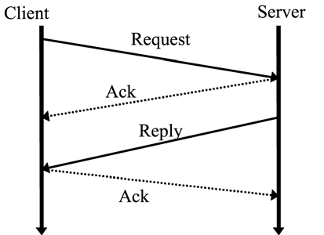
RPC Protocol Implementation [1]
Given a completely reliable communication environment, which never loses, duplicates, or reorders messages, and given client and server processes that never fail, RPC would be trivial to solve.
The sender would merely package the invocation into one or more messages and transmit these to the server.
The server would unpack the data into local variables, perform the desired operation, and send back the result (or an indication of any exception that occurred) in a reply message.

Slide 16
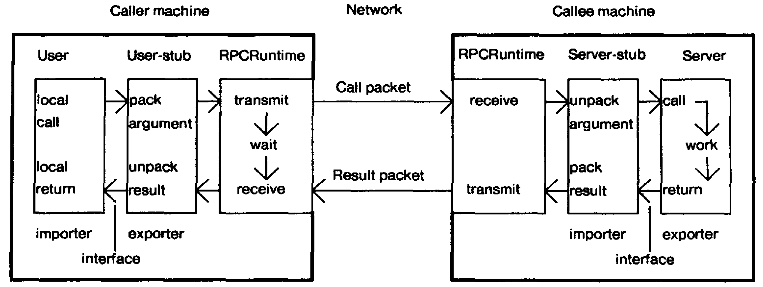
Stubs (Proxies) and Messages [2]
The process of encoding the function arguments is known as marshalling.

Slide 18
RPC Framework Implementation Hurdles
Transport protocol: TCP? UDP? Both?
Parameter passing: All data must be sent in a pointerless representation.
Marshalling & RPC compiler.
Semantics of remote procedure calls. Local procedure call: executed exactly once each time it's invoked.
Service binding. How do we locate the server endpoint? Hard coded in program? Central database listing all services and their corresponding host & port #?
Performance.
Security handling.

Slide 19
RPC over TCP
Most implementations of RPC technologies like CORBA, XML-RPC, SOAP, Java RMI use TCP and not UDP as underlying transport.
TCP is preferred here because contrary to UDP it already cares about reliability (dealing with packet loss, duplication, reordering) and can also easily and transparently handle arbitrary sized messages.

Slide 20
RPC over UDP
RPC over UDP requires special UDP aware handling due to the nature of UDP sockets.
There is no connection, just datagrams sent to an address.
For the client to get a reply, it would have to set up a listening socket and then send that to the server along with the request. The server would then reply to the clients address.
net/rpc doesn't have any special case handling for non-connection oriented transports (i.e. UDP).

Slide 21
Client Code: Go Asynchronous RPC
https://pkg.go.dev/net/rpc#Client.Go
Go invokes the function asynchronously.
It returns the Call structure representing the invocation.
The done channel will signal when the call is complete by returning the same Call object.
If done is nil, Go will allocate a new channel. If non-nil, done must be buffered or Go will deliberately crash.

Slide 22
Client Code: Go Synchronous RPC
https://pkg.go.dev/net/rpc#Client.Call
Call invokes the named function, waits for it to complete, and returns its error status.
In actuality, Call is a wrapper around Go, which waits for the operation to complete, whereas Go is the underlying function, which leaves waiting up to the caller.
Clearly, in the background, a goroutine is involved somewhere, since this is a non-blocking operation.

Slide 23
Parameter Passing
Most parameters in our programs are passed by value.
That is easy to do remotely: just send the data in a network message.
Some parameters, however, are passed by reference.
A reference is a memory address of the parameter.
There is no good solution to this except to understand the data that is being referenced, send it to the remote side (pass by value).

Slide 24
Marshalling
All data that is sent needs to be represented as a series of bytes that can be placed into one or more network messages. This is known as marshalling.
Not only must any data structure be sent in a serialized format: a sequence of bytes with no pointers, but the format of this marshalled data must be standardized between the client and server so that the server can make sense of the data it receives and vice versa.

Slide 25
RPC Compiler
Since most languages do not support remote procedure calls natively, something has to generate client and server stubs. That is often a stand-alone program known as an RPC compiler, or protocol compiler.
The RPC compiler takes an interface specification as input and generates client-side stubs (proxies) and a server-side proxy (skeleton).
The interface specification is written in an interface definition language (IDL) and defines remote classes, methods, and data structures. It contains all the information that the RPC compiler needs to generate stub functions.

Slide 26
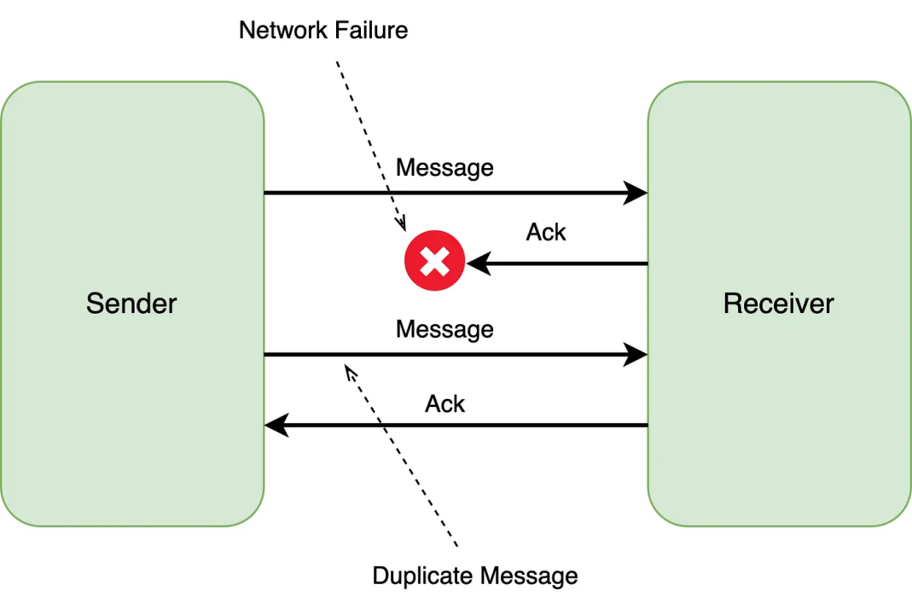
RPC Failures
The call didn't reach the server.
The call was executed but mid-way the server crashed.
The call was executed, the results were returned but the return message did not reach the client.

Slide 27
At-most-once Semantics
Send request, don't retry, update may not happen.
The server either executes the call once or not at all.
request_sent = False
while not request_sent: # only care about msg delivery
ack = send_RPC_and_wait_for_ack(timeout=T)
request_sent = True
if ack and ack.FAILURE:
request_sent = True

Slide 28
At-least-once Semantics
Retry request until acknowledged, may repeat update.
method_executed = False
while not method_executed:
ack = send_RPC_and_wait_for_ack(timeout=T)
if ack and ack.SUCCESS:
method_executed = True

Slide 29
Exactly-once Semantics
The exactly once semantics make sure that a procedure will be executed exactly once and only once.
The universal algorithm for ensuring this combines an acknowledgment (ACK) scheme combined with timestamps (or some other incremental counter that allows the server to distinguish between duplicate messages).

Slide 30
Exactly-once Semantics Implementation
The general approach is for the client to send an RPC (Remote Procedure Call) to the server along with a timestamp and start a timeout timer. The client will then wait for one of two outcomes: (1) it receives an ACK from the server confirming that the procedure was completed, or (2) it times out.
If the client times out, it assumes the server was unable to complete the procedure and sends the RPC again with the same timestamp.
There are two reasons the client might not receive the ACK: (3) the server never received the original RPC, or (4) the server received and completed the RPC, but the ACK was lost.
In case (3), the ACK mechanism allows the server to eventually receive and perform the RPC.
In case (4), the server receives the duplicate RPC, identifies it as a repeat using the timestamp, and does not perform the procedure again. However, the server must still send a second ACK to let the client know the RPC was completed.

Slide 31
Performance
Without a doubt, a remote procedure call will be much slower.
We can easily expect the overhead of making the remove call to be thousands of times slower than a local one.
However, that should not deter us from using remote procedure calls since there are usually strong reasons for moving functions to the server.

Slide 32
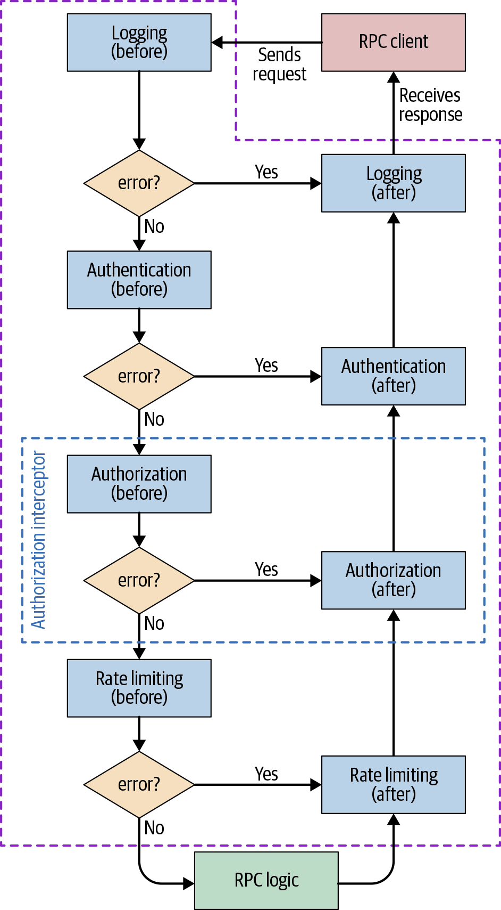
RPC Framework with Security [3]

Slide 34
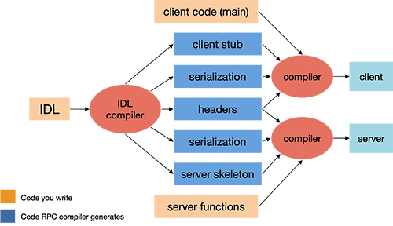
Programming with RPCs in Languages Without Built-In Syntax for RPCs
Examples: C, C++, Scheme.

Slide 36
1. Create Key Value Store
mkdir "Key Value Store"
cd "Key Value Store"
mkdir server
mkdir client
mkdir shared

Slide 37
2. Create types.go
const (
OK = "OK"
ErrNoKey = "ErrNoKey"
)
type Err string
type PutArgs struct {
Key string
Value string
}
type PutReply struct {
Err Err
}
type GetArgs struct {
Key string
}
type GetReply struct {
Err Err
Value string
}

Slide 38
3. Create server.go (I)
import (
"log"
"net"
"net/rpc"
"sync"
kvs "kvs/shared"
)
type KV struct {
mu sync.Mutex
data map[string]string
}

Slide 39
4. Create server.go (II)
func (kv *KV) Put(args *kvs.PutArgs, reply *kvs.PutReply) error {
kv.mu.Lock()
defer kv.mu.Unlock()
kv.data[args.Key] = args.Value
reply.Err = kvs.OK
return nil
}

Slide 40
5. Create server.go (III)
func (kv *KV) Get(args *kvs.GetArgs, reply *kvs.GetReply) error {
kv.mu.Lock()
defer kv.mu.Unlock()
val, ok := kv.data[args.Key]
if ok {
reply.Err = kvs.OK
reply.Value = val
} else {
reply.Err = kvs.ErrNoKey
reply.Value = ""
}
return nil
}

Slide 41
6. Create server.go (IV)
func server() {
kv := new(KV)
kv.data = map[string]string{}
rpcs := rpc.NewServer()
rpcs.Register(kv)
l, e := net.Listen("tcp", ":1234")
if e != nil {
log.Fatal("[S] Listen error:", e)
}
fmt.Println("[S] Wait for connection...")

Slide 42
7. Create server.go (V)
count := 1
var done sync.WaitGroup
done.Add(1)
go func() {
for {
conn, err := l.Accept()
if err == nil {
fmt.Println("[S] Handle connection " + strconv.Itoa(count) + ".")
go rpcs.ServeConn(conn)
count++
} else {
break
}
} l.Close()
}() done.Wait()
}

Slide 43
8. Create and Run main.go
go run .
package main
func main() {
server()
}

Slide 44
9. Create client.go (I)
import (
"log"
"net/rpc"
kvs "kvs/shared"
)
func connect() *rpc.Client {
client, err := rpc.Dial("tcp", ":1234")
if err != nil {
log.Fatal("[C] Dialing:", err)
}
return client
}

Slide 45
10. Create client.go (II)
func put(key string, val string) {
client := connect()
args := kvs.PutArgs{key, val}
reply := kvs.PutReply{}
err := client.Call("KV.Put", &args, &reply)
if err != nil {
log.Fatal("[C] Error:", err)
}
client.Close()
}

Slide 46
11. Create client.go (III)
func get(key string) string {
client := connect()
args := kvs.GetArgs{key}
reply := kvs.GetReply{}
err := client.Call("KV.Get", &args, &reply)
if err != nil {
log.Fatal("[C] Error:", err)
}
client.Close()
return reply.Value
}

Slide 47
12. Create main.go
func main() {
key := "my_number"
var wg sync.WaitGroup
for i := 1; i <= 10; i++ {
wg.Add(1)
go func(n int) {
defer wg.Done()
putValue := strconv.Itoa(n)
fmt.Printf("[C] Calling put(\"%s\", \"%s\")...\n", key, putValue)
put(key, putValue)
}(i)
}
wg.Wait()
value := get(key)
fmt.Printf("[C] get(%s): %s\n", key, value)

Slide 48
13. Run main.go
go run .

Slide 50
struct Type
struct is a sequence of fields.
Each field consists of optional name and required type.
type T1 struct {
f1 string
} type T2 struct {
T1 // Field T1 is called an embedded field since it's declared with type but no name.
f2 int64
f3, f4 float64
} func main() {
t := T2{T1{"NHBien"}, 1, 2, 3}
fmt.Println(t.f1) // NHBien
fmt.Println(t.T1.f1) // NHBien
fmt.Println(t.f4) // 3
}

Slide 51
Tags
A field declaration may be followed by an optional string literal (tag) which becomes an attribute of all the fields in the corresponding field declaration (single field declaration can specify multiple identifiers).
Tags are accessible through reflect package which allows run-time reflection.
Probably the most common use of tags in Go is marshalling.
type T struct {
f1 string "f one"
f2 string
f3 string `f three`
f4, f5 int64 `f four and five`
}

Slide 52
1. Create fieldTags.go (I)
package main
import (
"encoding/json"
"fmt"
)
type Person struct {
FirstName string `json:"first_name"`
LastName string `json:"last_name"`
MiddleName string `json:"middle_name,omitempty"`
}

Slide 53
2. Create fieldTags.go (II)
func main() {
json_string := `
{
"first_name": "Bien",
"last_name": "Ngo"
}` person := new(Person)
json.Unmarshal([]byte(json_string), person)
fmt.Println("First Name:", person.FirstName)
fmt.Println("Middle Name:", person.MiddleName)
fmt.Println("Last Name:", person.LastName)
person.MiddleName = "Huy" new_json, _ := json.Marshal(person)
fmt.Printf("%s\n", new_json)
}

Slide 54
3. Run fieldTags.go
go run fieldTags.go

Slide 56
1. Create multipleFieldTags.go (I)
package main
import (
"encoding/json"
"encoding/xml"
"fmt"
)
type Person struct {
FirstName string `json:"first_name" xml:"fname"`
LastName string `json:"last_name" xml:"lname"`
MiddleName string `json:"middle_name,omitempty" xml:"mname,omitempty"`
}

Slide 57
2. Create multipleFieldTags.go (II)
func main() {
json_string := `
{
"first_name": "Bien",
"last_name": "Ngo"
}`
person := new(Person)
json.Unmarshal([]byte(json_string), person)
fmt.Println("First Name:", person.FirstName)
fmt.Println("Middle Name:", person.MiddleName)
fmt.Println("Last Name:", person.LastName)
person.MiddleName = "Huy"
new_json, _ := json.Marshal(person)
fmt.Printf("%s\n", new_json)

Slide 58
3. Create multipleFieldTags.go (III)
xml_string := `
<person>
<fname>John</fname>
<lname>Smith</lname>
</person>
`
john := new(Person)
xml.Unmarshal([]byte(xml_string), john)
fmt.Println("First Name:", john.FirstName)
fmt.Println("Middle Name:", john.MiddleName)
fmt.Println("Last Name:", john.LastName)
}

Slide 59
4. Run multipleFieldTags.go
go run multipleFieldTags.go

Slide 61
Remote Procedure Calls [4]
Remote procedure call refers to the technique of making a local call and having it execute on a remote service somewhere.
There are a number of different types of RPC technology out there. Some of this technology relies on having an interface definition (SOAP, Thrift, protocol buffers).
The use of a separate interface definition can make it easier to generate client and server stubs for different technology stacks.
All these technologies, however, have the same, core characteristic in that they make a local call look like a remote call.
The core idea of RPC is to hide the complexity of a remote call.

Slide 62
Local Calls are Not Like Remote Calls
I can make large numbers of local, in-process calls without worrying overly about the performance.
With RPC, though, the cost of marshalling and unmarshalling payloads can be significant, not to mention the time taken to send things over the network.
Networks aren't reliable. They can and will fail, even if your client and the server you are speaking to are fine.

Slide 63
Brittleness
public class Customer implements Serializable {
private String firstName;
private String surname;
private String emailAddress;
private String age;
}
If the server implementation removes age from its definition of this type, and we don't do the same to all the consumers, then even though they never used the field, the code associated with deserializing the Customer object on the consumer side will break.

Slide 65
Go rpc vs. Go http
Binary format vs. Text-based format
Faster vs. Easier to Use
Internal communication vs. Public-facing APIs

Slide 66

Further Reading
Huseyin Babal (2023). gRPC Microservices in Go. Manning Publications.
Haishi Bai and Yaron Schneider (2020). Learning Dapr. O'Reilly Media.

Slide 67

Thank You & See You Again

